Slide 1
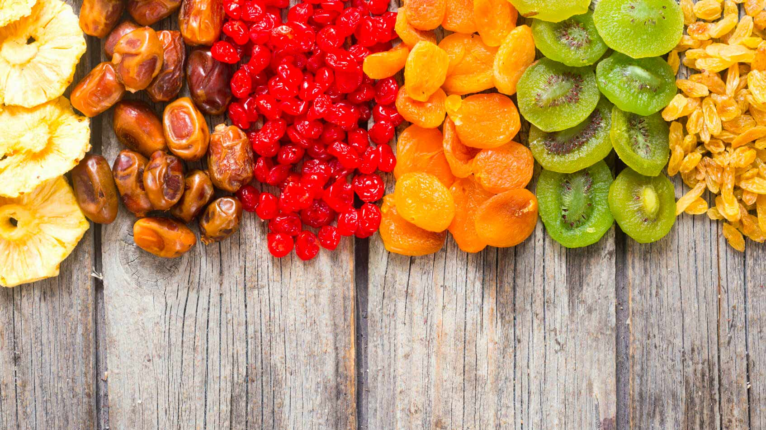
Smart Dehydration System
Group X

Slide 2
GROUP MEMBERS
Student ID | Name
10899225 | K.A.S.A.Kahandawa
10899366 | A.M.S.D.Senevirathne
10899381 | W.M.U.N.Wickramasinghe
10899202 | K.U.D.L.Darshana
10899377 | A.A.Udaraka
10898677 | B.A.Ranamuka

Slide 3
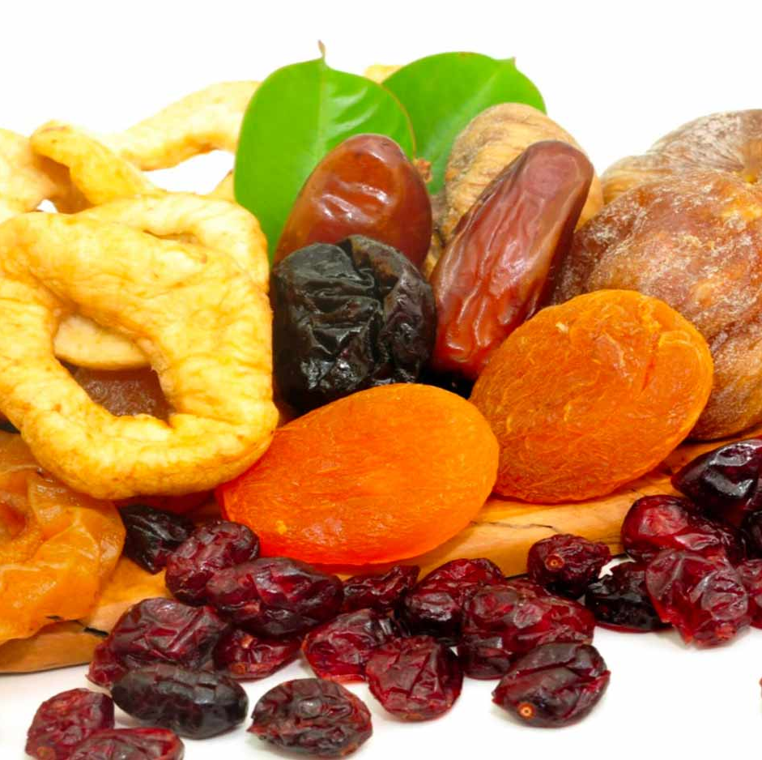
CONTENT
Introduction
Purpose and Objectives
Key Components
Key Benefits
Problems and solutions
User-Friendly Design
Future Works

Slide 4
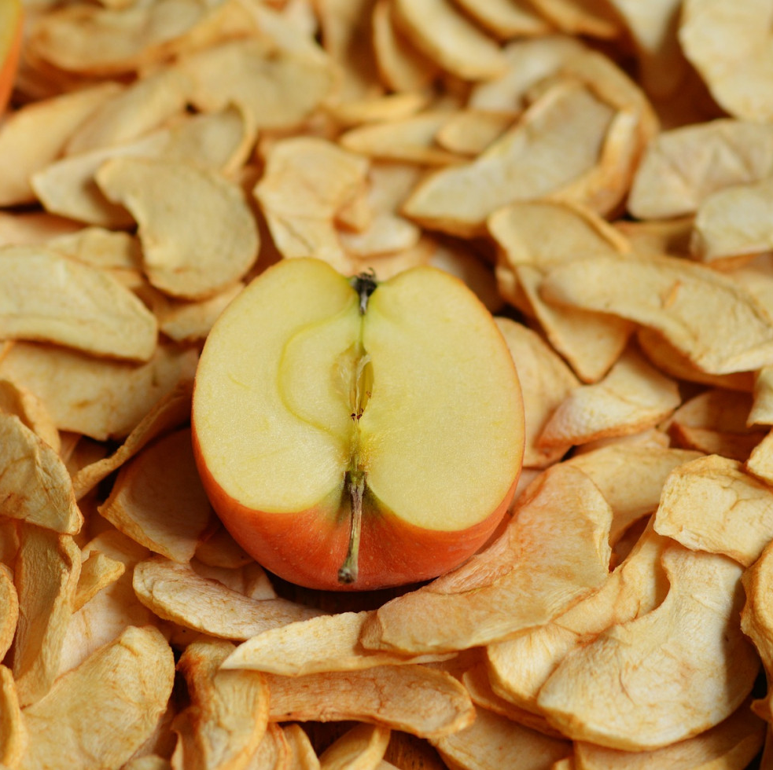
INTRODUCTION
Our Smart Dehydration Machine consistently and precisely handles waste. Suitable for both professionals and average people, it blends technology and ease of use. Food can be efficiently preserved while retaining its flavour and nutrients. It's the perfect dehydrating companion for food companies or health-conscious individuals alike.

Slide 5

PURPOSE
To revolutionize food preservation by introducing a cutting-edge solution that addresses the challenges of traditional dehydration methods.
To provide a reliable and efficient way to preserve fruits, vegetables, and other perishables while retaining their nutritional value and flavour.
To cater to the needs of both home users and professionals in the food industry, offering a versatile solution for dehydration requirements.

Slide 6
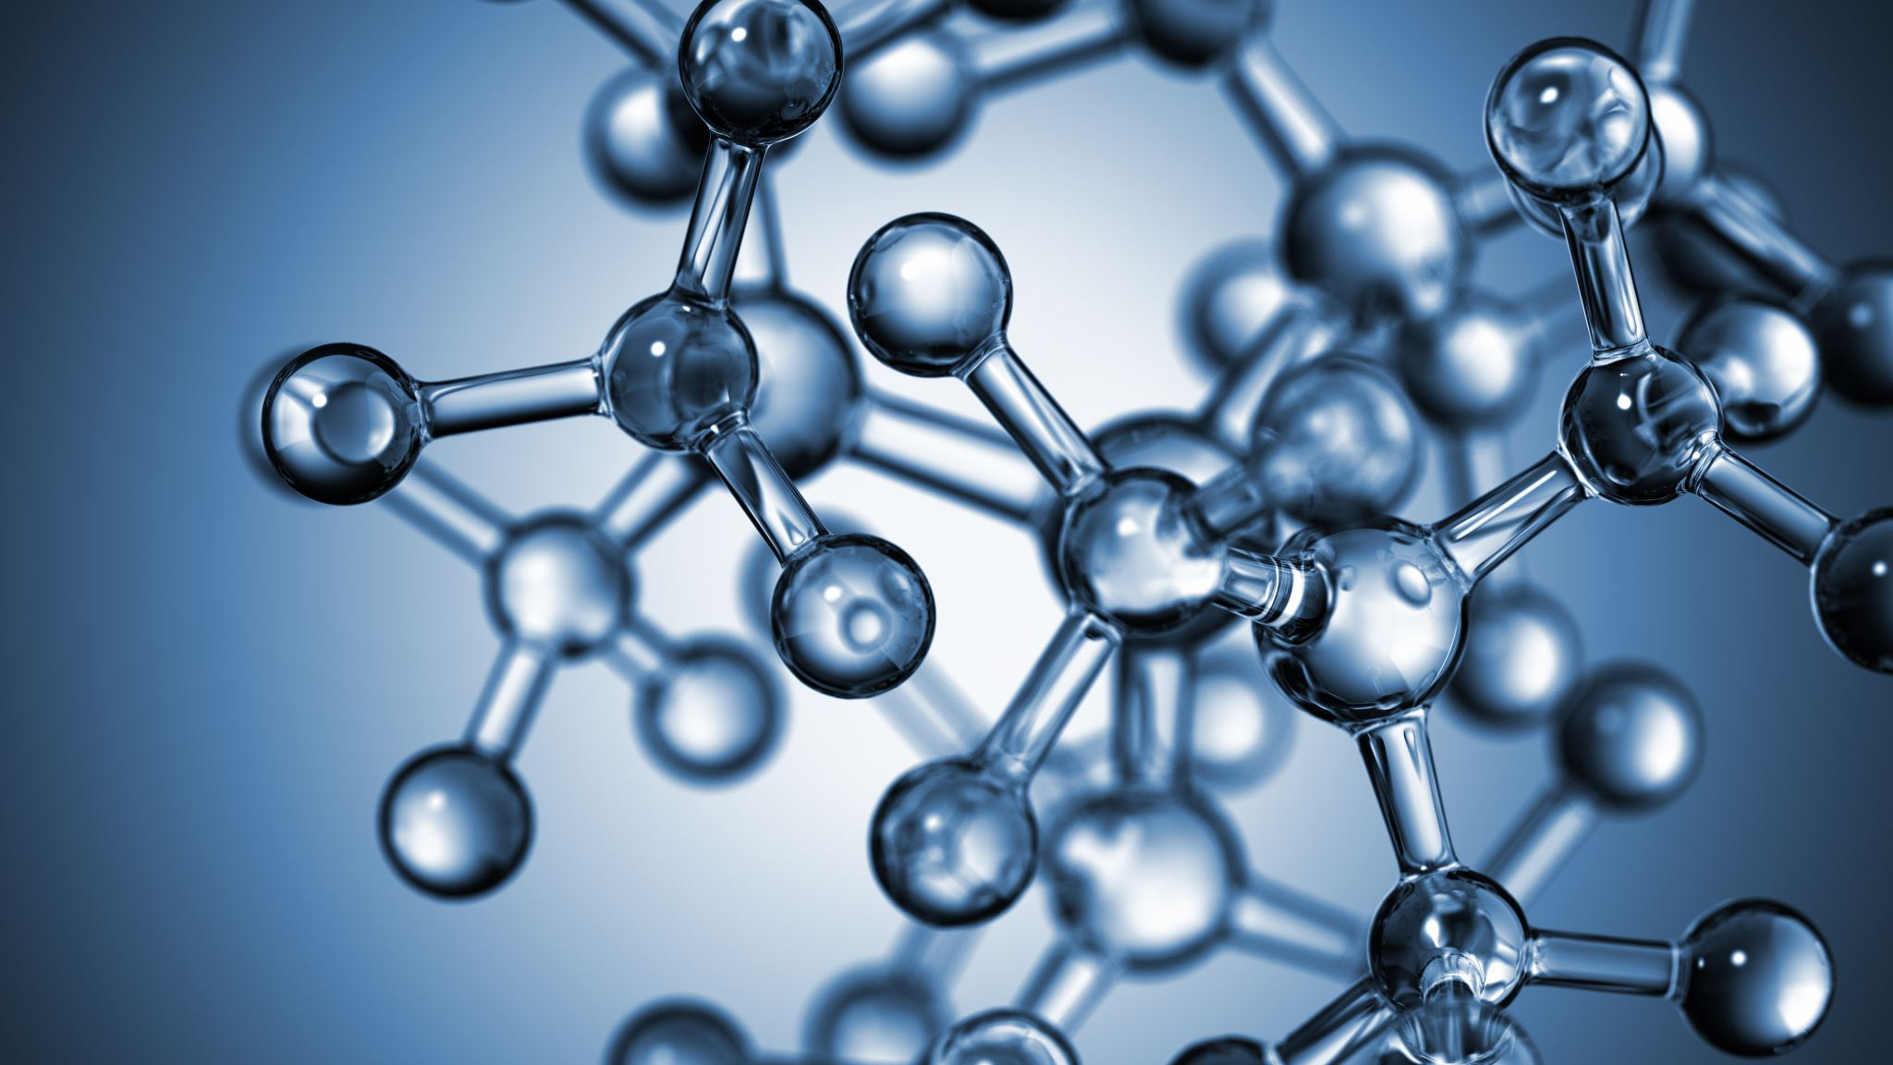
OBJECTIVES
Integrate advanced technology with user-friendly features to make food preservation accessible and intuitive for all users.
1
Expand market reach by targeting both individual consumers and businesses in the food industry, showcasing the versatility and benefits of the Smart Dehydration Machine.
2
Maintain the nutritional value and flavour of preserved food to promote healthier eating habits and consumer satisfaction
3

Slide 7
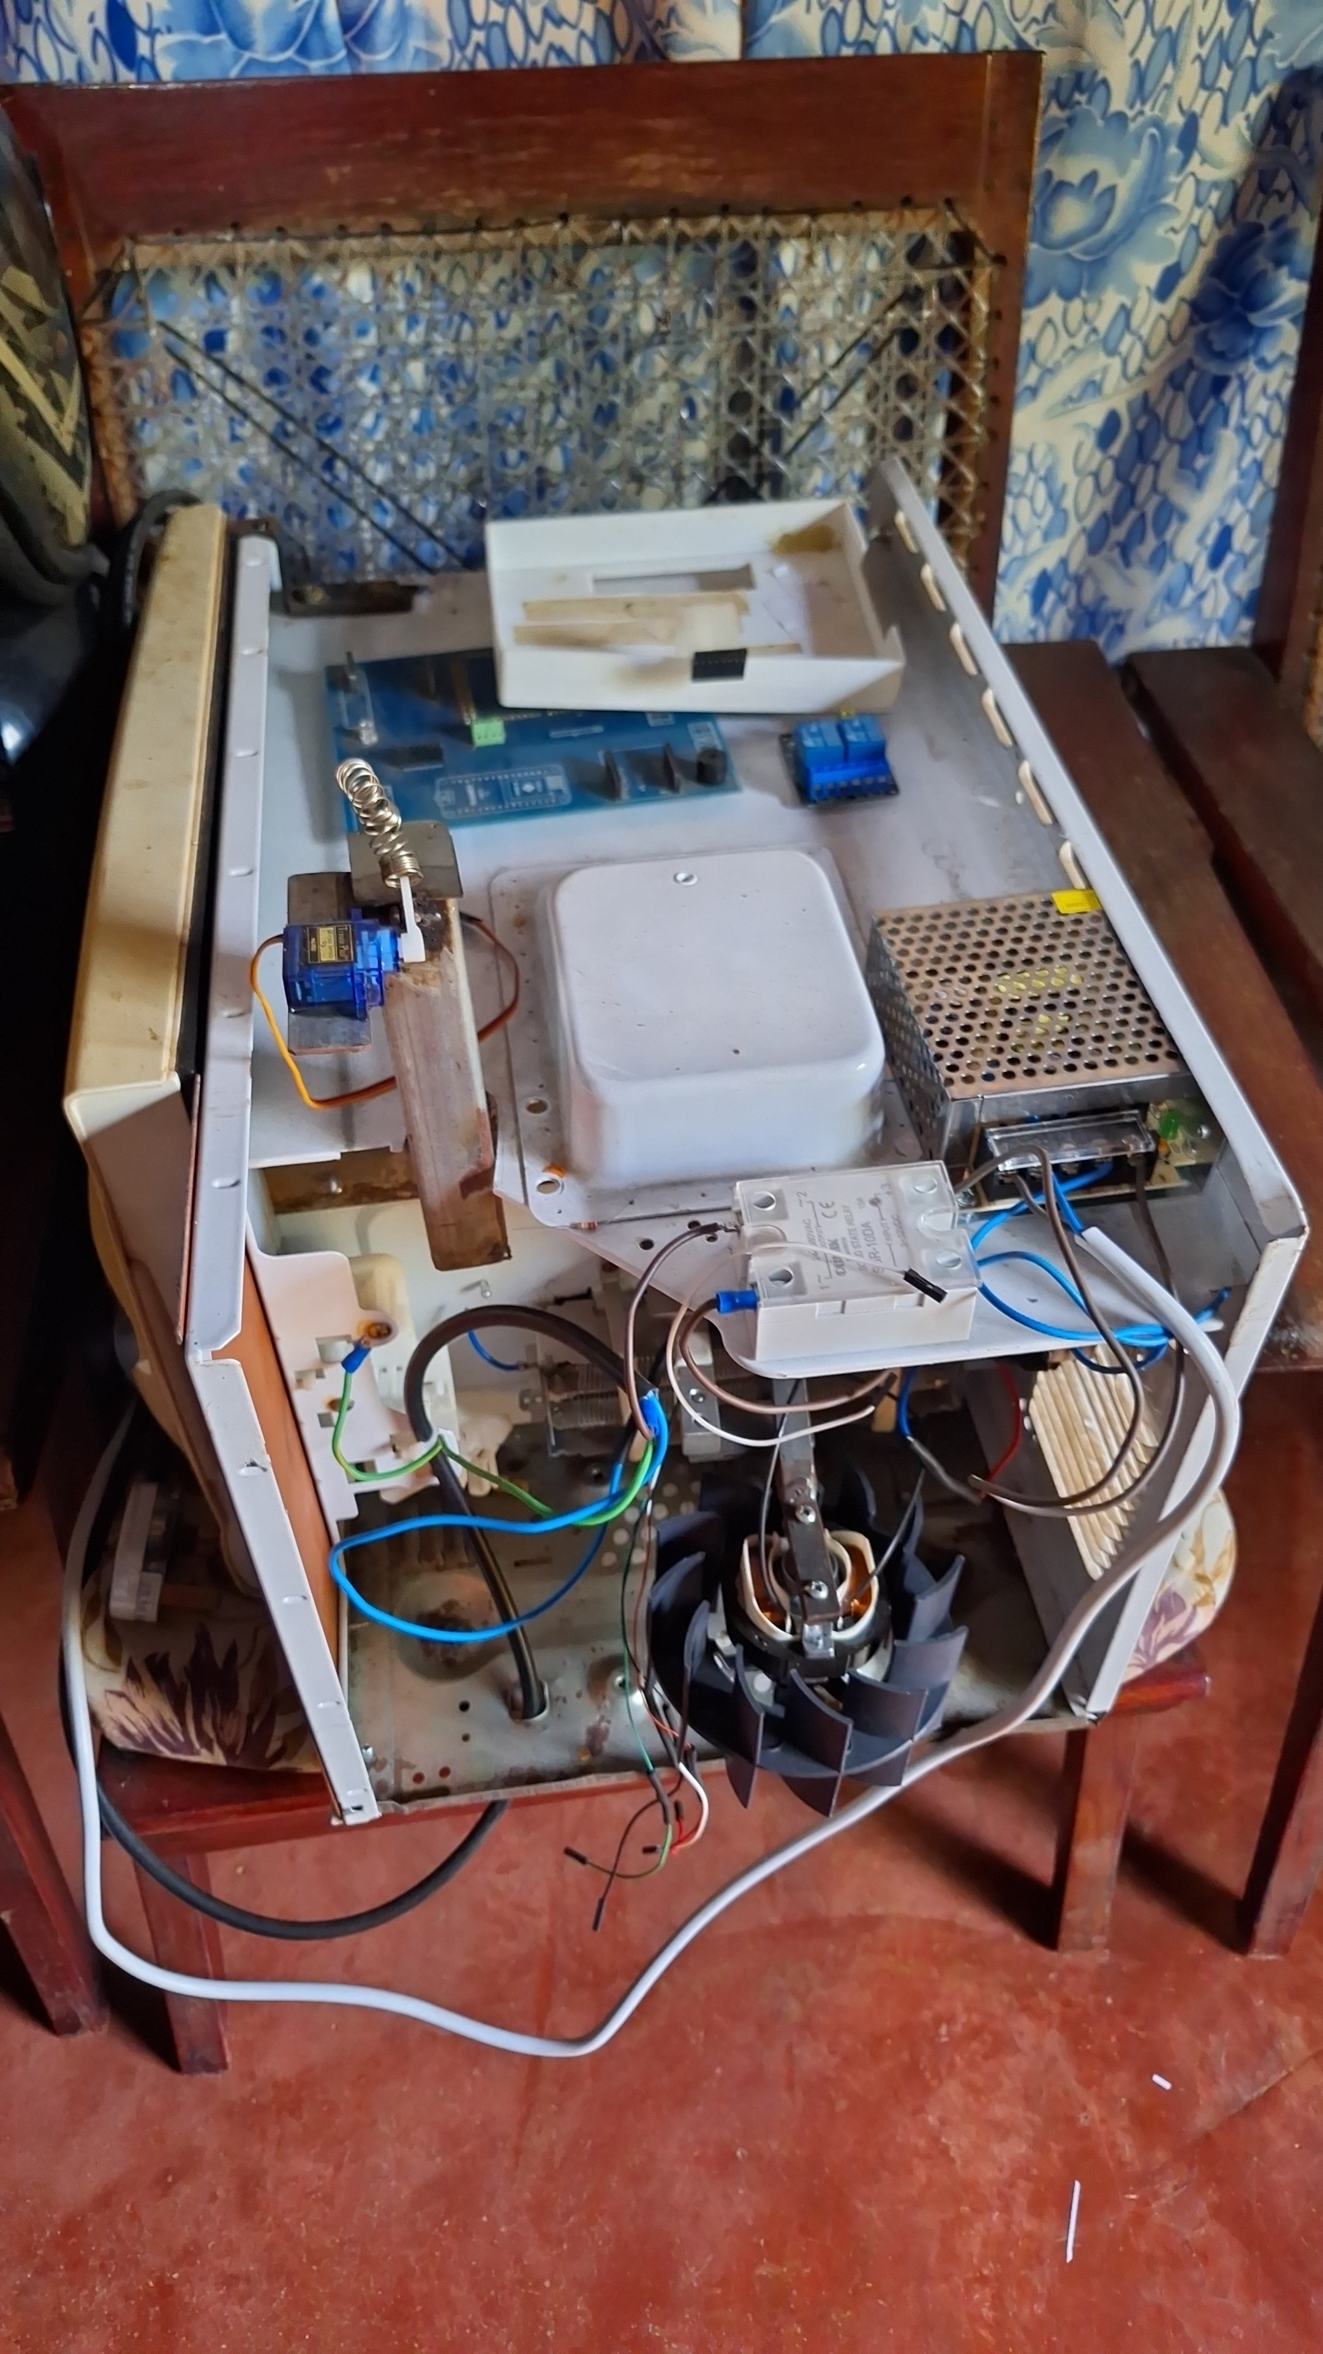
KEY COMPONENTS
Arduino Mega
ESP32 Wi-Fi Module
Temperature Sensor
Humidity Sensor
Load Cell Sensor
Power Supply
Heater
Blower Fan
Servo Motor
Relay Modules
Solid State Relay (SSR)

Slide 8

KEY BENEFITS
Precision Dehydration
Customizable Modes
Efficient Heating System
Weight Scaling Capability

Slide 9
USER-FRIENDLY DESIGN
Manual Mode with LCD Display
Web Server Integration

Slide 10
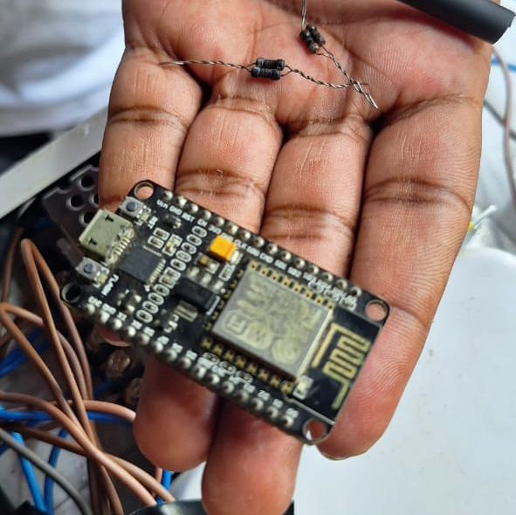
PROBLEMS AND SOLUTIONS

Slide 11
Problem | Solution
⁠Load Cell Stability | Exploring more stable load cell options, implementing calibration techniques, and applying signal filtering algorithms.
⁠Integration Complexity | We're making our software and communication methods more efficient . referring new techniques and using some ais we created more accurate codes and try many times to configure both boards.
Sensor Data Transmission | as a future implement, we hope to make web app with mobile application and hope to pass all values to our Ui. and we hope to analysis data and give best and smooth experience to our user.
failed to configure automation mode | we create a logical code for automation mode using the weight of the fruit. The scale of fruits is related to temperature level and according to that dehydration time is automatically setting using our data analyzing. after finishing the all conditions, the dehydration process will be finishing. we failure to merge both codes together and get a accurate result.
Damage Due to Overvoltage | we use some resisters to control the fan speed .because we create 3 fan speed levels and according to that we can provide 3 temperature levels to dehydration process.so we had to use some resisters to the power supply unit and due to over resistance, all resisters are get burned.

Slide 12
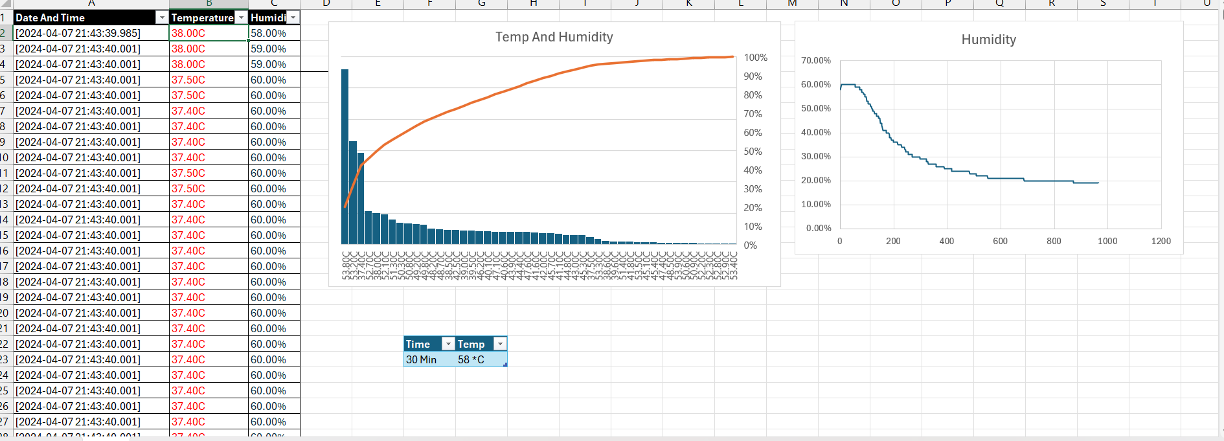
DATA ANALYSIS

Slide 13
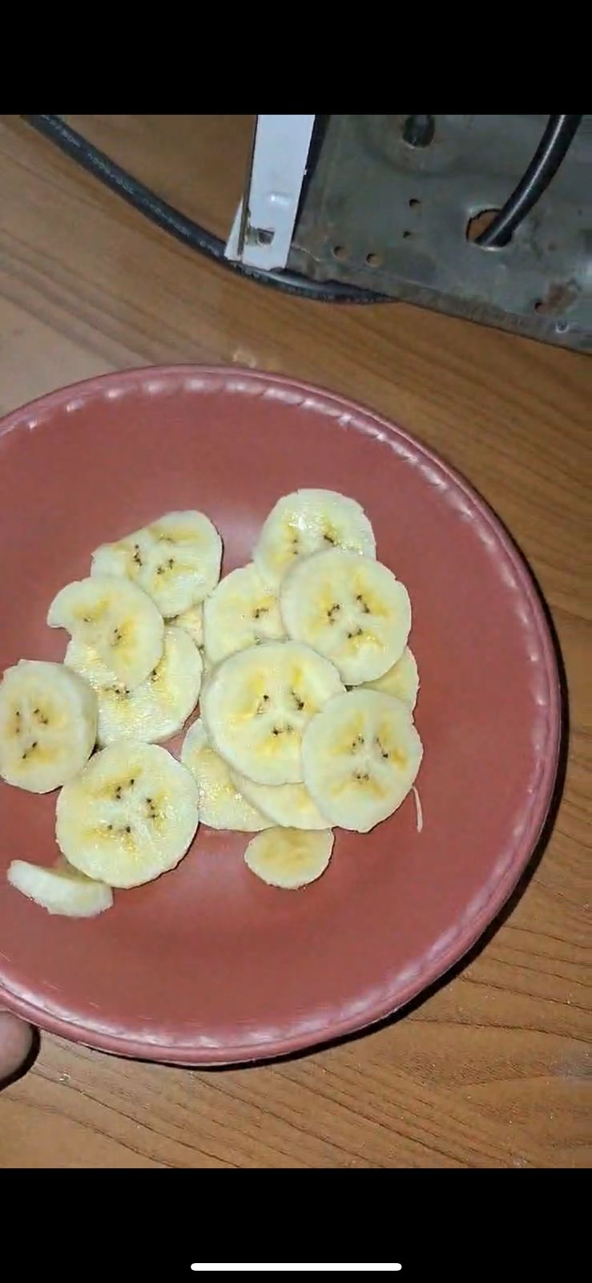
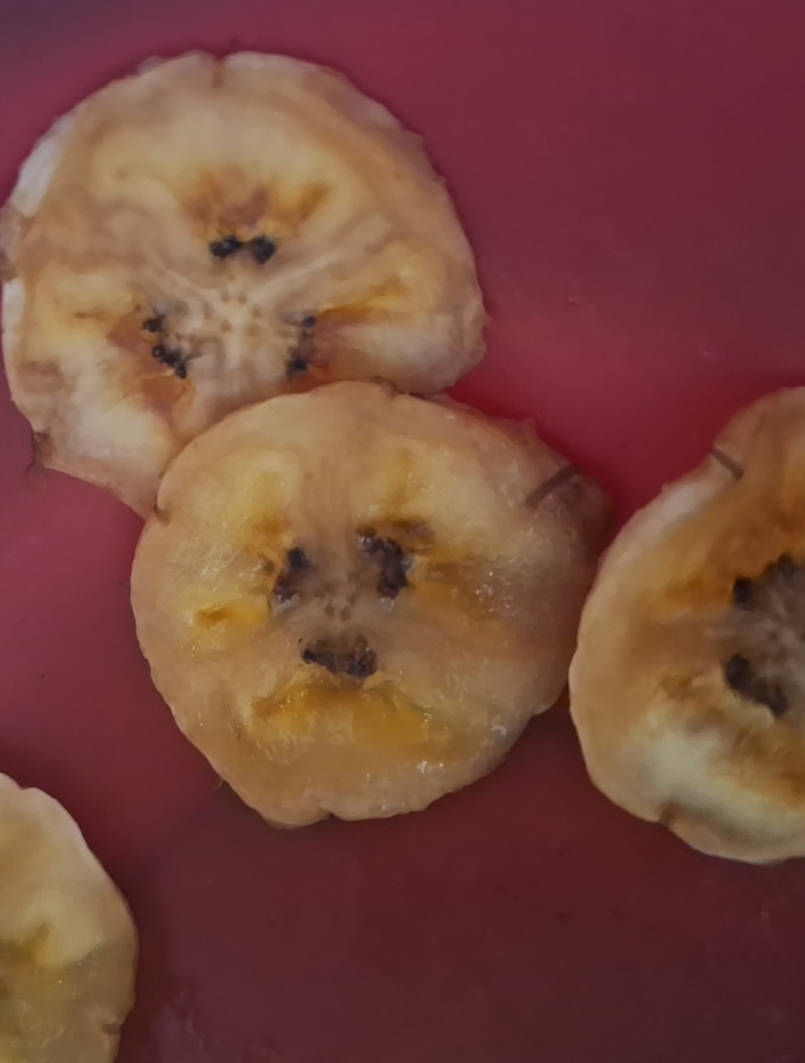
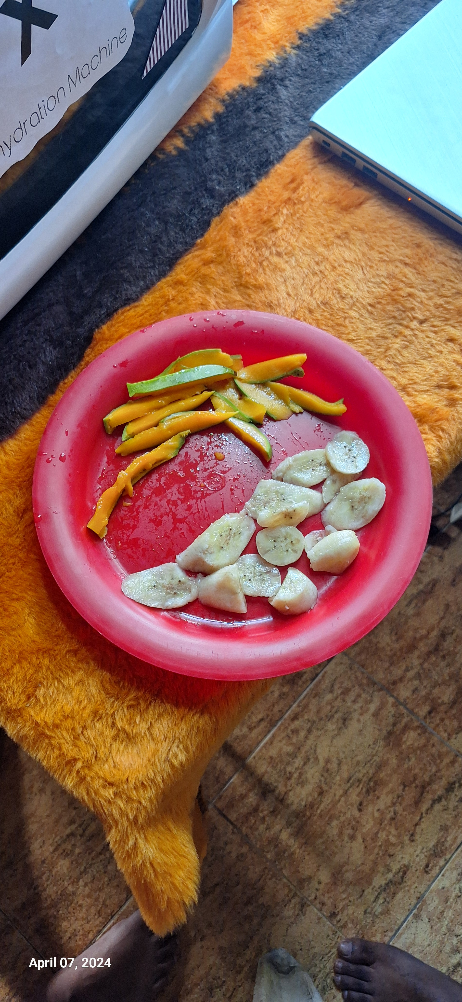
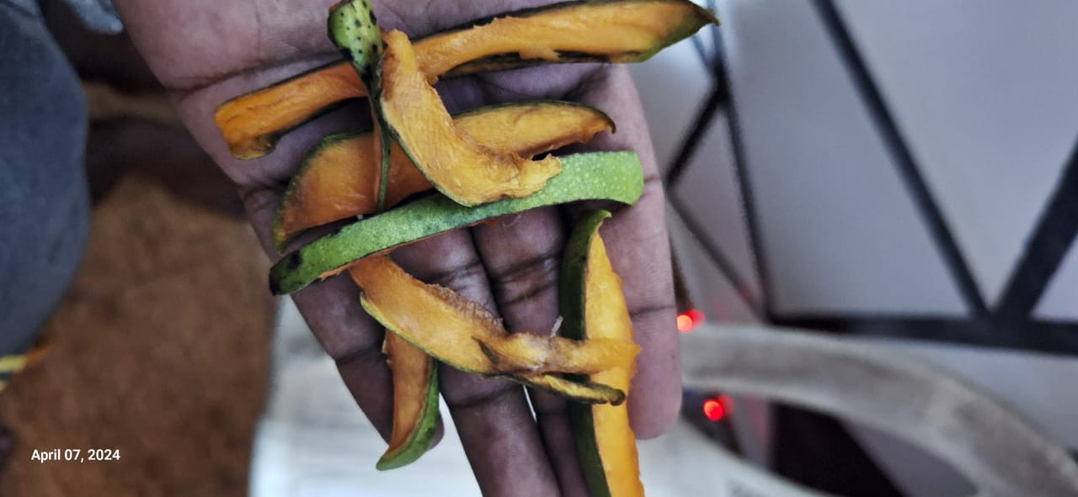
BEFORE VS AFTER DEHYDRATION

Slide 14
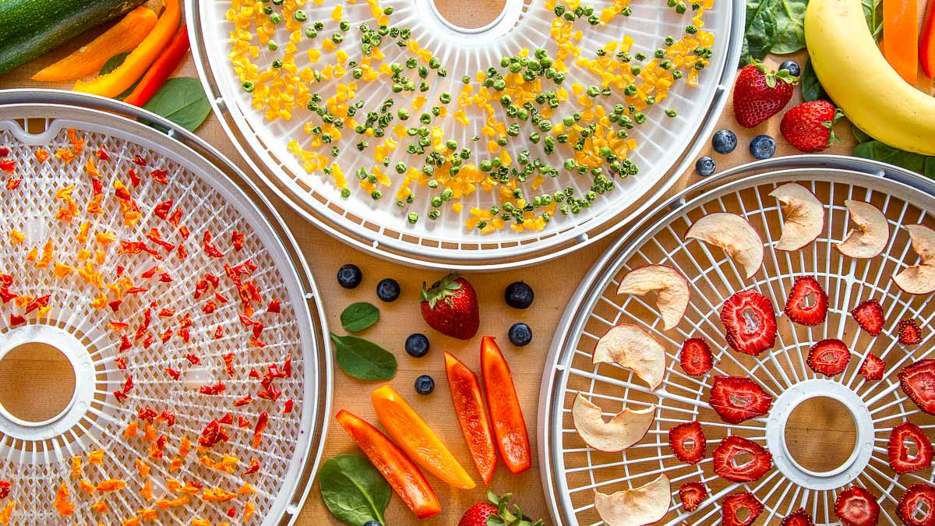
Thank you !

